Slide 7



Slide 10




Slide 14




Slide 15










Slide 16

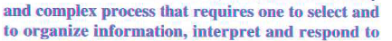


Slide 17




Slide 19
Conflicts
Conflicts: 3 Types of Conflicts
1. Intrapersonal Conflicts, 2. Interpersonal Conflicts and 3. Unconscious Conflicts.
The word conflict has been derived from a Latin word ‘Conflicts’ which means ‘strike two things at the same time’.
Conflicts occur in the individual when more than one, equally powerful desires or motives present at the same time and pressurize for immediate satisfaction.

Slide 20
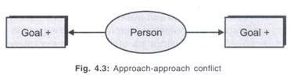
a. Intrapersonal conflicts:
These are the conflicts caused within the individual. These conflicts arise as a result of two or more motives or goals to be achieved at a time. Hence, these are called goal conflicts.
1. Approach-approach conflict:
In this type of conflict individual will have two desires with positive valence which are equally powerful. For example, a person has two attractive job offers and he has to choose any one of them- tension arises.

Slide 21

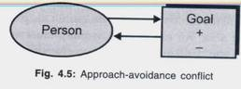
2. Avoidance-avoidance conflict:
This conflict involves two goals with negative valence
both are unwanted goals
For example, a woman must work at a job which she dislikes very much or else she has to remain unemployed
3. Approach-avoidance conflict:
Here the goal object will have both positive and negative valences.
A person is approaching to accept a job offer, because the salary is attractive- but at the same time he is repelled back as the job is very risky.

Slide 22
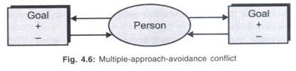
4. Multiple-approach-avoidance conflict:
both positive and negative valences of multiple nature
2. Interpersonal conflicts:
Interpersonal conflict is caused between individuals.
3. Unconscious Conflict:
The mental conflict below the level of conscious awareness is called unconscious conflict. The conflicts in conscious level, when repressed, shifts to unconscious

Slide 26
The rules of assertion
I have the right to:
1. Respect myself: who I am and what I do.
2. Recognise my own needs as an individual: separate from what is expected of me in roles such as 'wife', 'husband', 'partner', 'parent', ‘daughter'.
3. Make clear 'I' statements about how I feel and what I think: for example, 'I feel very uncomfortable with your decision.'
4. Allow myself to make mistakes: recognise that it is normal to make mistakes.
5. Change my mind: if I choose.

Slide 27
The rules of assertion
6. Ask for 'thinking time': for example, when people ask you to do something, you have the right to say: 'I would like to think about it and I will let you know my decision'.
7. Allow myself to enjoy my successes: feel pleased about what I have done and share it with others.
8. Ask for what I want: rather than hoping someone will notice what I want.
9. Recognise that I am not responsible for the behaviour of other adults: you are only responsible for your own actions.
10. Respect other people: and their right to be assertive in return.

